Slide 1
Satellite-Based National Intertidal-Zone Mapping of Continental Norway with Sentinel-1&2
Jörg Haarpaintner
Corine Davids
Norwegian Research Centre AS
Tromsø
Project M-1646, avtalenummer 19087497.
Contact: Tomas Holmern

Slide 2
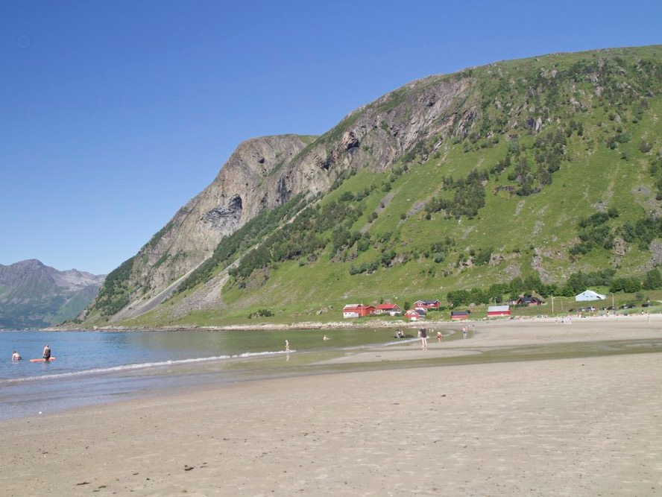
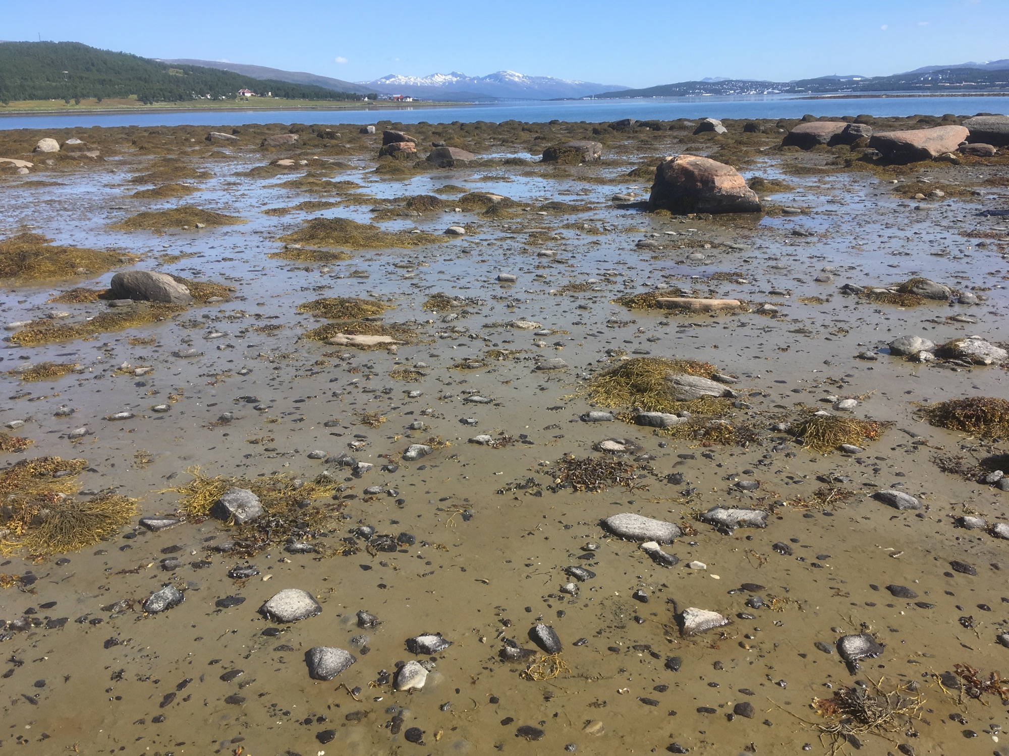
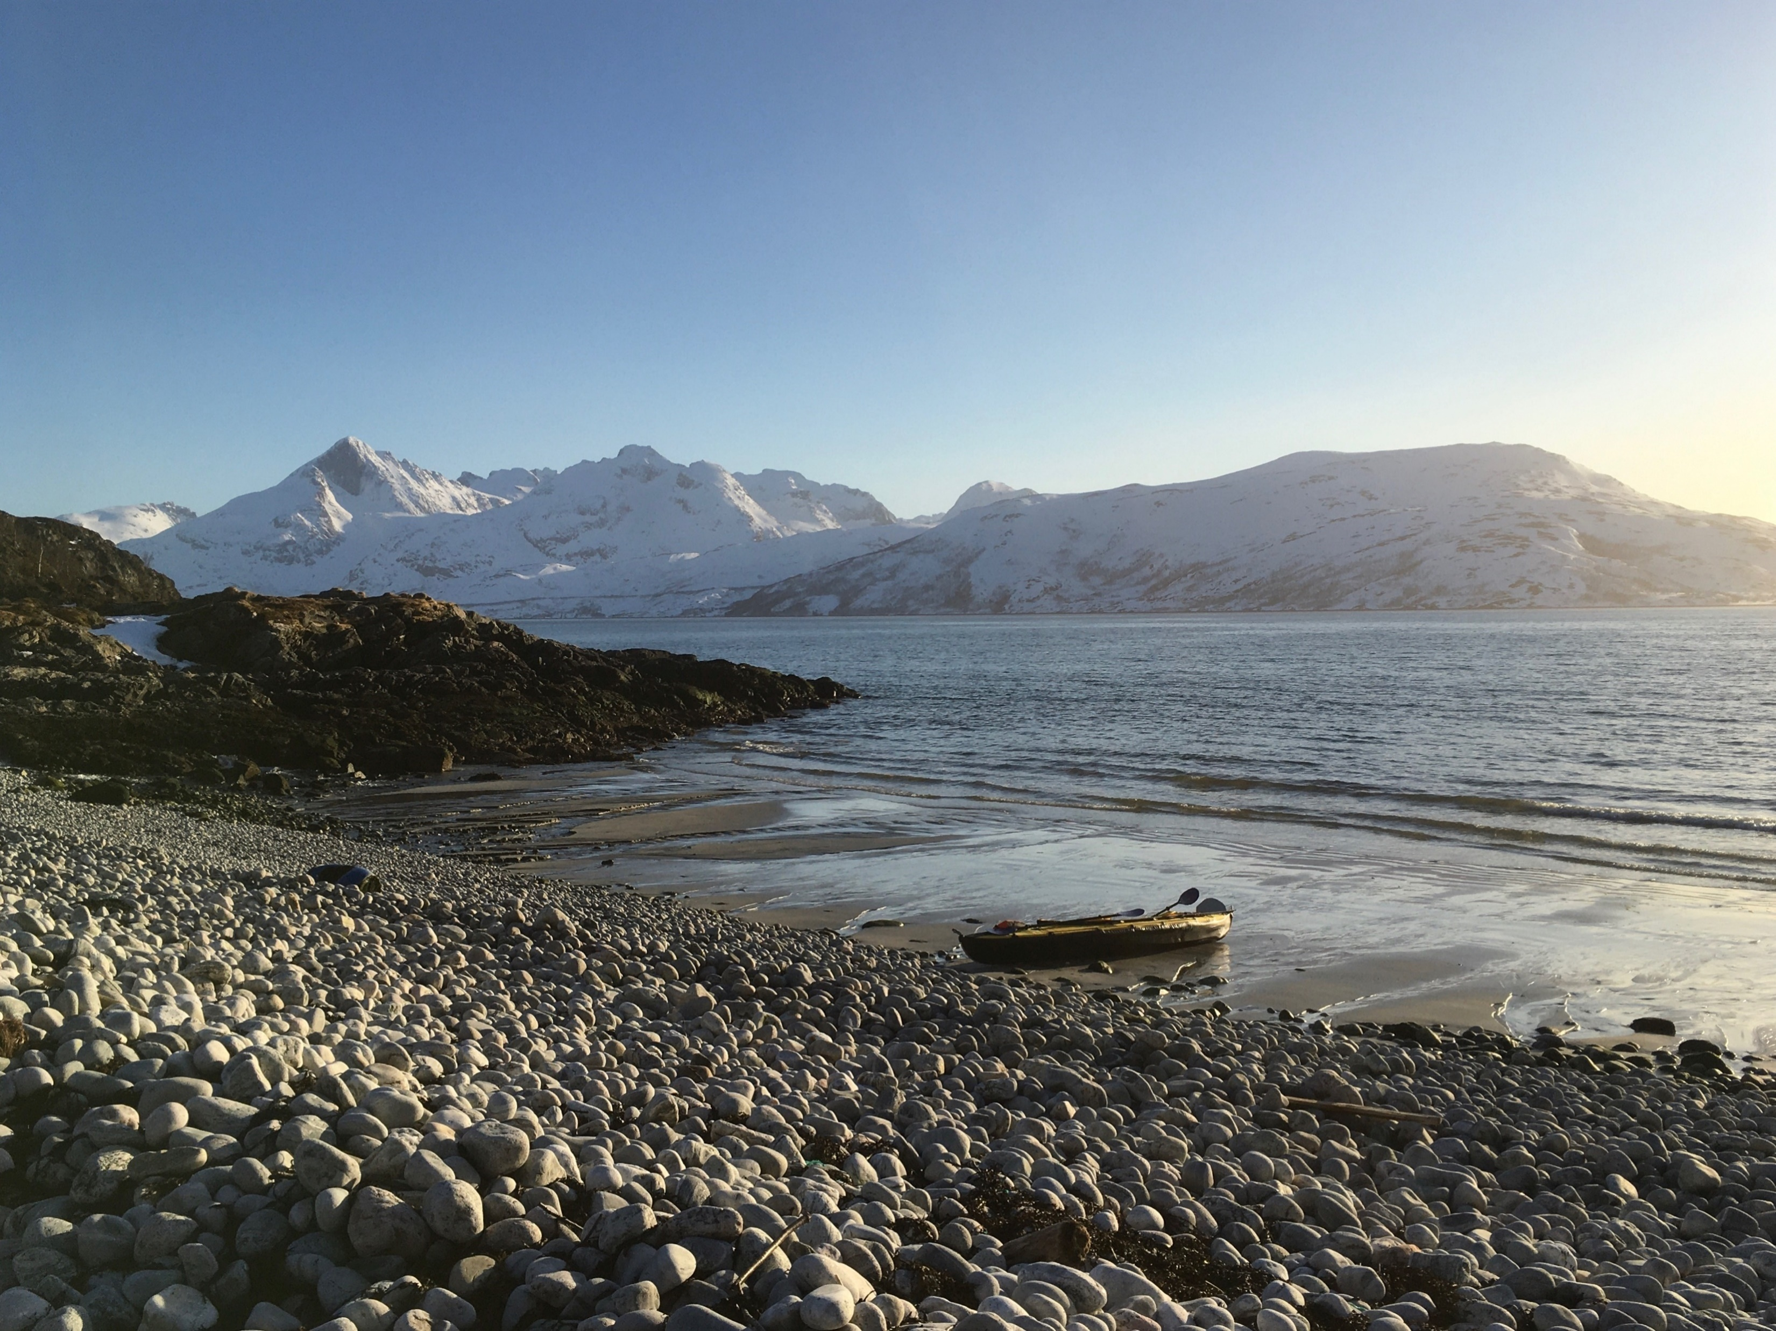
The Intertidal Zone (ITZ) is …
A vulnerable coastal ecosystem with high biodiversity providing important ecosystem services.
A highly dynamic area that, on a national scale, can only be monitored by dense time-series of satellite data.
The Sentinel-1 & 2 satellites of the Copernicus Program
provide near-daily radar (cloud independent) and optical imagery of 10m resolution that can sample the tidal cycle on a national scale.
S1 & S2 based methods have been developed to map the atmospheric exposure (AtmExp), the type and the area of the ITZ.

Slide 3
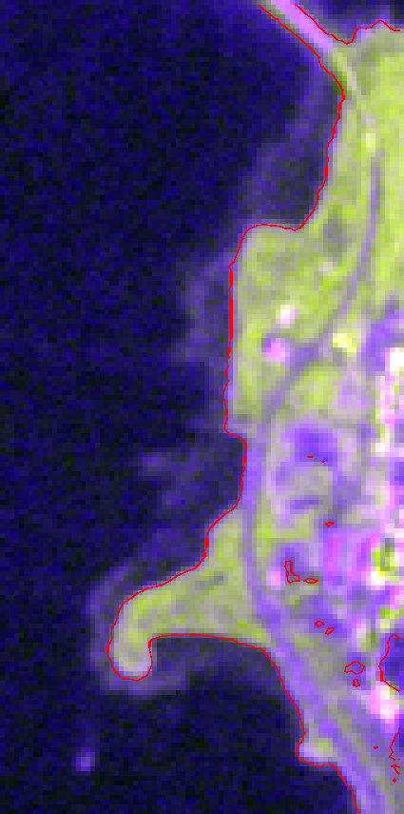
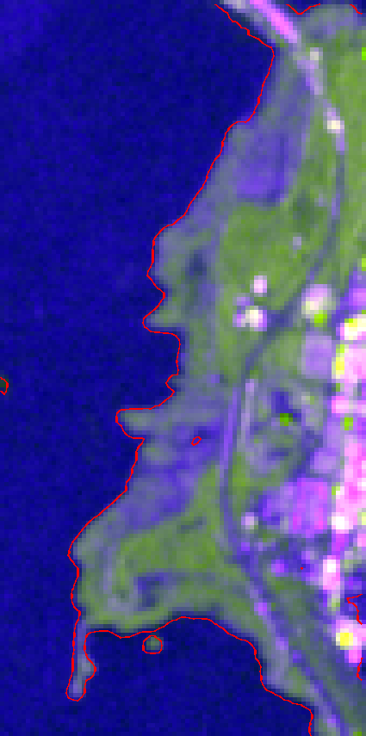
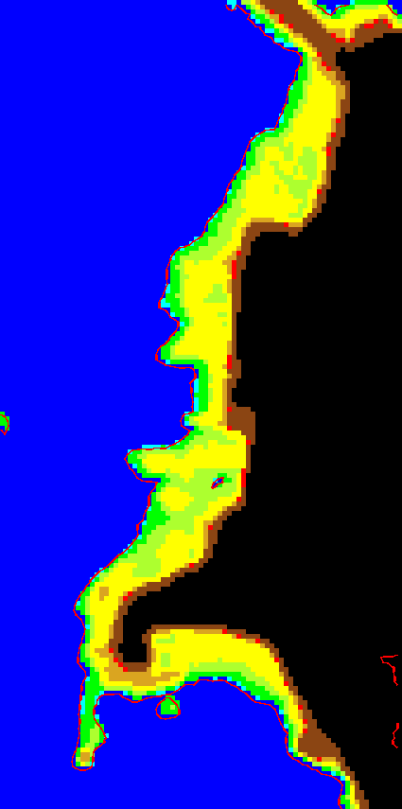
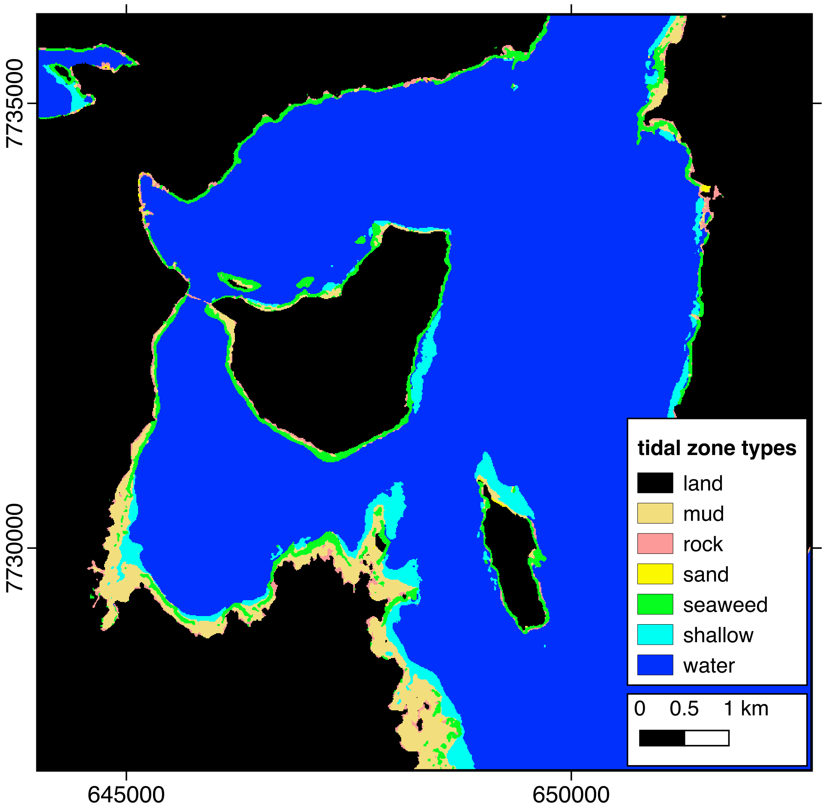
Methods
5 %
95 %
AtmExp
ITZ AtmExp is mapped by statistical analysis of Sentinel-1 C-band synthetic aperture radar: Land-Water thresholding of different backscatter percentiles correspond directly to tidal levels and thereby to atmospheric exposure.
ITZ Types are mapped by statistical analysis of Sentinel-2 MultiSpectral data (MSI) and derived vegetation and water indices and distinguishes between land, rock, mud, sand, seaweed, shallow water and water.
ITZ Area can be extracted from ITZ AtmExp and ITZ Type independently and combined into one multi-sensor product giving high confidence to areas where they agree and low where they disagree.

Slide 4
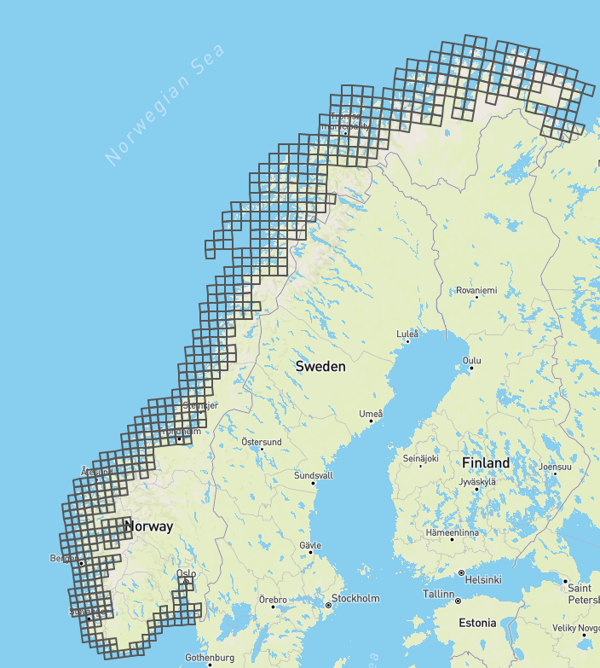
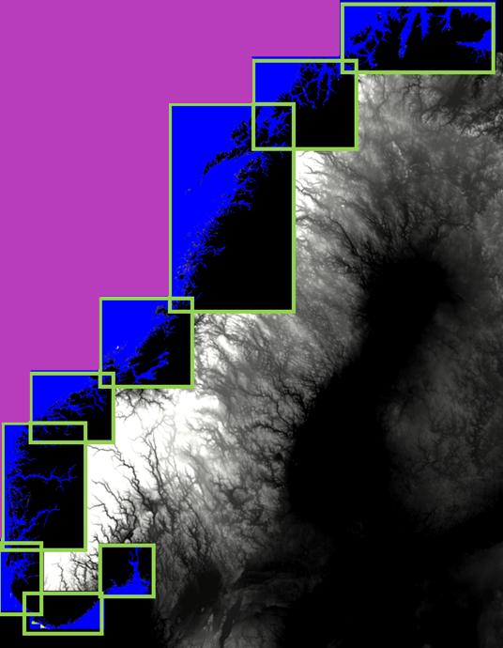
National Processing
Three final products were made for each county:
ITZ atmospheric exposure (based on S1)
ITZ type (based on S2)
ITZ Area (based on S1 and S2) providing a measure of confidence.
Processing of S1 data was done in-house, while processing S2 data was implemented in Google Earth Engine.
The methods have been applied along the whole Norwegian coast and products are divided into 9 county products.

Slide 5
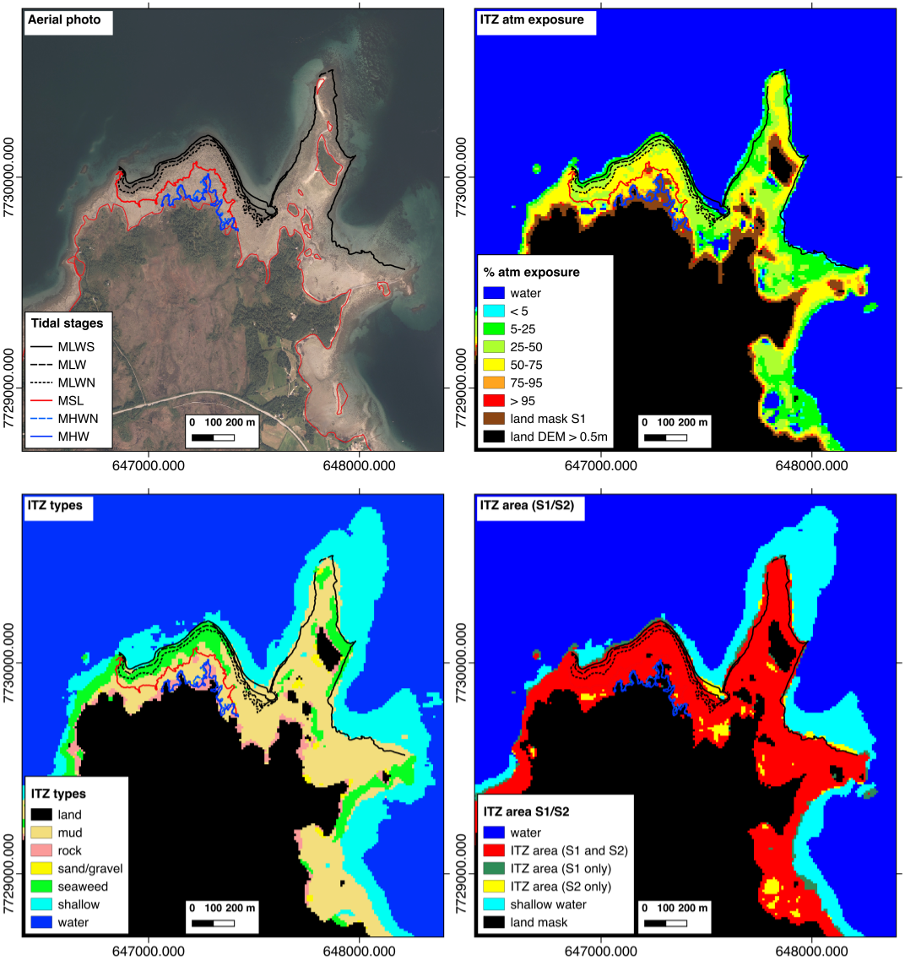
Results
Final products provide information on the extent of the ITZ, % atmospheric exposure, and different land cover types in the ITZ.
Validation
The products have been assessed against:
in-situ data from 7 field visits (GPS tracks of water lines and ground photos),
aerial mosaics from norgeibilder.no, and
“mudflats” in MD’s naturbase
Accuracies
of ITZ areas above MSL, MLW and MLWS are 99%, 84% and 64%, respectively.
of ITZ types are overall 81%.

Slide 6
Conclusion and Outlook
Time series of Sentinel-1 and Sentinel-2 are well suited to map the intertidal zone in high, 10 m, resolution.
Validation and accuracy assessments indicate general good quality of the products.
Identified sources of errors can likely be resolved with further development of the methods, additional field data for training and validation and by manual clean-up.
For operational monitoring on a yearly based, the accuracy of the national products should be assessed on a county level with additional field data, the processing lines need to be further automized, also in regard to the combination of S1 and S2
Future possibilities for development for additional products include change detection in the ITZ, other intertidal zone land cover types.
Other future product development opportunities include fish farm detection and boat occupancies in harbors.

Slide 7
Thank you for your attention.
Acknowledgements
H. Hindberg, I. Arntzen, N. Borch → python scripting for national processing
Satellite and aerial data has been provided by
norgeibilder.no
https://kart.naturbase.no/
Funded by
Miljødirektoratet, Project M-1646, avtalenummer 19087497.
Contact: Tomas Holmern

